Slide 1
Complete architecture of dbms
By : parul madan(ap)
Cse(geu)

Slide 2
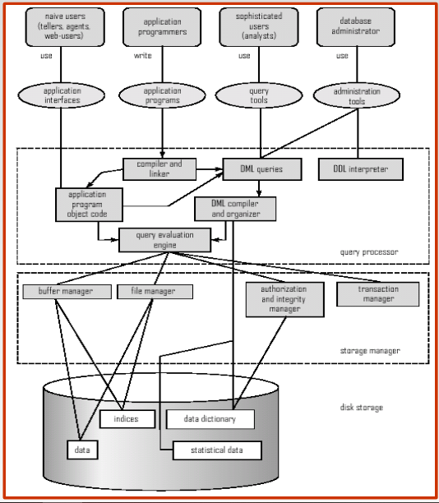

Slide 4
Different types of Database Users
Database users are categorized based up on their interaction with the database.
These are seven types of data base users in DBMS.
Database Administrator (DBA) :
Database Administrator (DBA) is a person/team who defines the schema and also controls the 3 levels of database.
The DBA will then create a new account id and password for the user if he/she need to access the data base. DBA is also responsible for providing security to the data base and he allows only the authorized users to access/modify the data base.
DBA also monitors the recovery and back up and provide technical support.
The DBA has a DBA account in the DBMS which called a system or superuser account.
DBA repairs damage caused due to hardware and/or software failures.

Slide 5
2. Naive / Parametric End Users : Parametric End Users are the unsophisticated who don’t have any DBMS knowledge, but they frequently use the data base applications in their daily life to get the desired results. For examples, Railway’s ticket booking users are naive users. Clerks in any bank is a naive user because they don’t have any DBMS knowledge, but they still use the database and perform their given task.
3. System Analyst : System Analyst is a user who analyzes the requirements of parametric end users. They check whether all the requirements of end users are satisfied.

Slide 6
4. Sophisticated Users : Sophisticated users can be engineers, scientists, business analyst, who are familiar with the database. They can develop their own data base applications according to their requirement. They don’t write the program code, but they interact the data base by writing SQL queries directly through the query processor.
5. Data Base Designers : Data Base Designers are the users who design the structure of data base which includes tables, indexes, views, constraints, triggers, stored procedures. He/she controls what data must be stored and how the data items to be related.

Slide 7
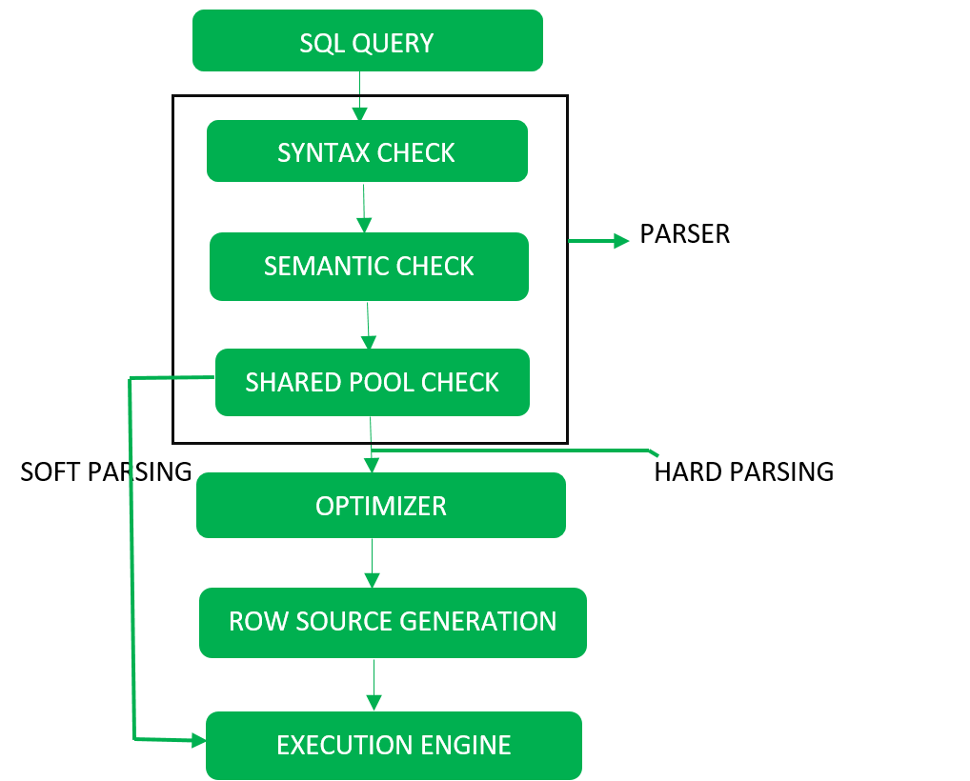
Query processing steps

Slide 8
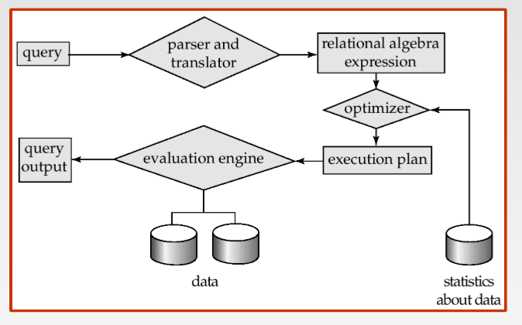

Slide 9
6. Application Program : Application Program are the backend programmers who writes the code for the application programs. They are the computer professionals. These programs could be written in Programming languages such as Visual Basic, Developer, C, FORTRAN, COBOL etc.
7. Casual Users / Temporary Users : Casual Users are the users who occasionally use/access the data base but each time when they access the database, they require the new information, for example, Middle or higher-level manager.

Slide 10
Components of database management system
Query Processor
It is one of the functional components of DBMS. The database manager understands that the query processor translates statements into low-level instructions in a query language. It may also attempt to find an equivalent but more efficient form.
It contains the following components:
DML Compiler The DML compiler converts DDL(data definition language) statements in the form of tables which stored metadata in a data dictionary. It also performs query optimization.

Slide 11
DDL Interpreter It is a device which interprets the DDL statements and some records into the data dictionary.
Query Evaluation Engine It executes low-level instructions generated by DML(data manipulation language) compiler. They mainly deal with solving all problems related to queries and query processing. It helps database system simplify and facilitate access to data.

Slide 12
DML Pre-compiler DML pre-complier converts DDL statements which are embedded in an application program into a normal procedure calls. The pre-compiler interacts with the query processor.
DML Compiler It converts DDL statements to a set of tables containing metadata stored in a data directory.

Slide 13
2.Storage Manager (Database Manager)
The database manager is the part of database management which manages all the organizations, storage and updating of data and provides an interface between the low-level data and some programs. The storage manager is responsible for many tasks. It provides interaction with the file manager.

Slide 14
The important components include:
File Manager It manages the allocation of disk space and data structures used to represents information on the disk.
Database Manager It is the interface between low-level data and applications programs and queries.
Transaction Manager Transaction manager ensures that the database remains in a consistent(correct) state despite system failures. Examples- power failure and operating system crashes.

Slide 15
Buffer Manager
The buffer manager is the software layer that is responsible for bringing pages from physical disk to main memory as needed. The buffer manages the available main memory by dividing the main memory into a collection of pages, which we called as buffer pool. The main memory pages in the buffer pool are called frames
Authorization and integrity manager:
It restricts users to access the data by putting constraints on table.

Slide 16
Disk storage
Data dictionary:
A data dictionary is a file or a set of files that contains a database's metadata. The data dictionary contains records about other objects in the database, such as data ownership, data relationships to other objects, and other data. ... Typically, only database administrators interact with the data dictionary
In SQL Server the data dictionary is a set of database tables used to store information about a database's definition. The dictionary contains information about database objects such as tables, indexes, columns, datatypes, and views.

Slide 17
Indices:
Indexing is used to optimize the performance of a database by minimizing the number of disk accesses required when a query is processed. The index is a type of data structure. It is used to locate and access the data in a database table quickly.
Statistical data:
A statistical database is a database used for statistical analysis purposes. It is an OLAP (online analytical processing), instead of OLTP (online transaction processing) system. Statistical databases typically contain parameter data and the measured data for these parameters.

